Slide 1
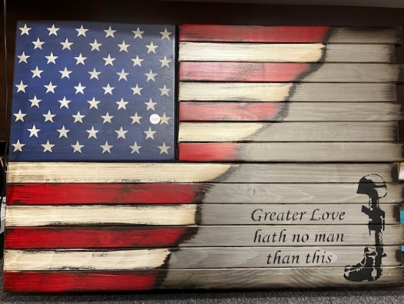
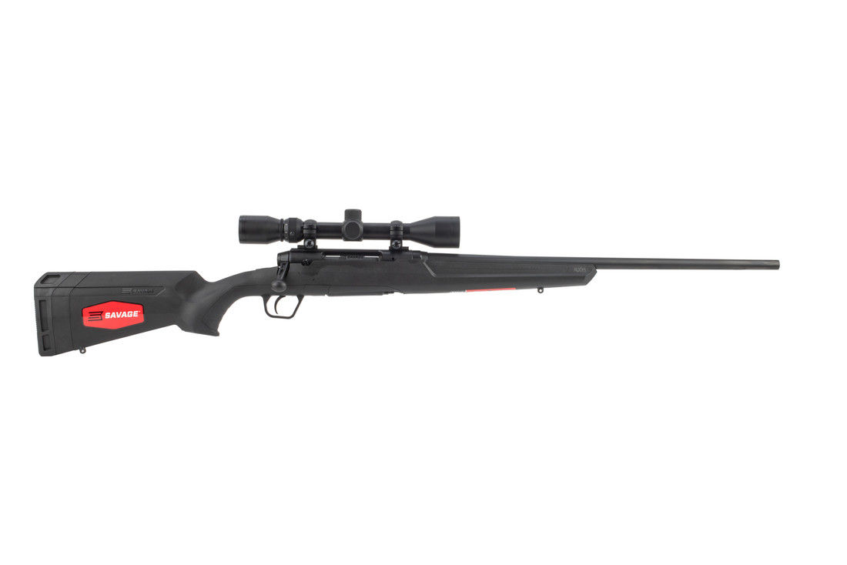
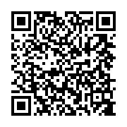
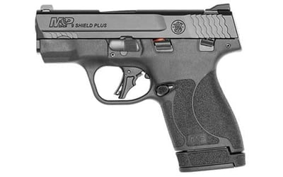
TOMBALL VFW POST 2427 RAFFLE FLAG GUNCASE & GUNS DRAWING 7/16/24 1 TICKET FOR $5.00 5 TICKETS FOR $20.00 GUN CASE DONATED BY BARRY GRANGER OF ATS MECHANICAL 1ST PLACE Wall MOUNT GUNCASE 2ND PLACE SMITH & WESSON 3RD PLACE SAVAGE XP GUNS PROVIDED BY JASON CLARKE BEAR ARMS OF TX.
Savage XP 243 With Weaver 3x9x40
Buy Tickets ONLINE
Smith & Wesson
M&P Shield

